Slide 1
Capstone Project
Telecom Churn Data – EDA Team - stars 1. Sai Krishna Vamshi Devarasetty (krishnavamshidevarasetty@gmail.com) 2. Gangadhar Palle (pallegangadhar156@gmail.com) 3. Abhishek Sharma (abhisheksharmatrio@gmail.com) 4. Nitish Rao – (nitishrao1896@gmail.com)

Slide 2
Telecom Churn Data – Intro
Orange S.A., formerly France Telecom S.A., is a French multinational telecommunications corporation. The Orange Telecom's Churn Dataset, consists of cleaned customer activity data (features), along with a churn label specifying whether a customer canceled the subscription.

Slide 3
Data Description
State – The state the telecom service user belongs to.
Account Length – How long account has been active.
Area Code – Identifier for a geographic region.
International Plan – Did user opted for International Plan ?
Voice mail Plan – Is Voice mail plan activated?
Number vmail messages – Number of voice mail messages sent.
Total day minutes–Total minutes used in day.
Total day calls – Total day calls made.
Total day charge – Total price user was charged for day calls.
Total eve minutes – Total minutes used
for calls in evening.
Total eve calls – Total evening calls made.
Total eve charge – Total price user was charged for evening calls.
Total night minutes – Total minutes used for calls in night.
Total night calls – Total night calls made.
Total night charge – Total price user was charged for night calls.
Total intl minutes – Total minutes used for international calls.
Total intl calls – Total calls made for international numbers
Total intl charge – Total price user was charged for international calls
Customer service calls – Number of Customer service calls user made.
Churn – Did user churned the services?

Slide 4
About Data
There are no missing values in any of the columns.
Except State, International plan, Voice mail plan and Churn all other columns are numerical(either int64 or float64)
Even though Area Code is numerical, it is not ordinal.
State is the only variable which is a string.
International plan and Voice mail plan are also given as type string(Yes/No) but we need to considered them as Boolean for analysis
Churn is bool type, True meaning users have churned and False implies who didn’t churned
Out of 3333 users 483 users Churned and 2850 didn’t churned

Slide 5
Problem Statements
Do Churned user speaking more during any specific duration (Day, Evening or night) compared to Non Churned ?
Does the user calls at particular duration has any impact on his calls of other durations ?
Do Area has any significant impact on Churned users ?
Do State has any impact on Churned users ?
Did opting for International plan resulted in Churning of users ?
Did opting for Voicemail plan resulted in Churning of Users ?
Did customers making more service calls churned more than those who didn’t ?

Slide 6
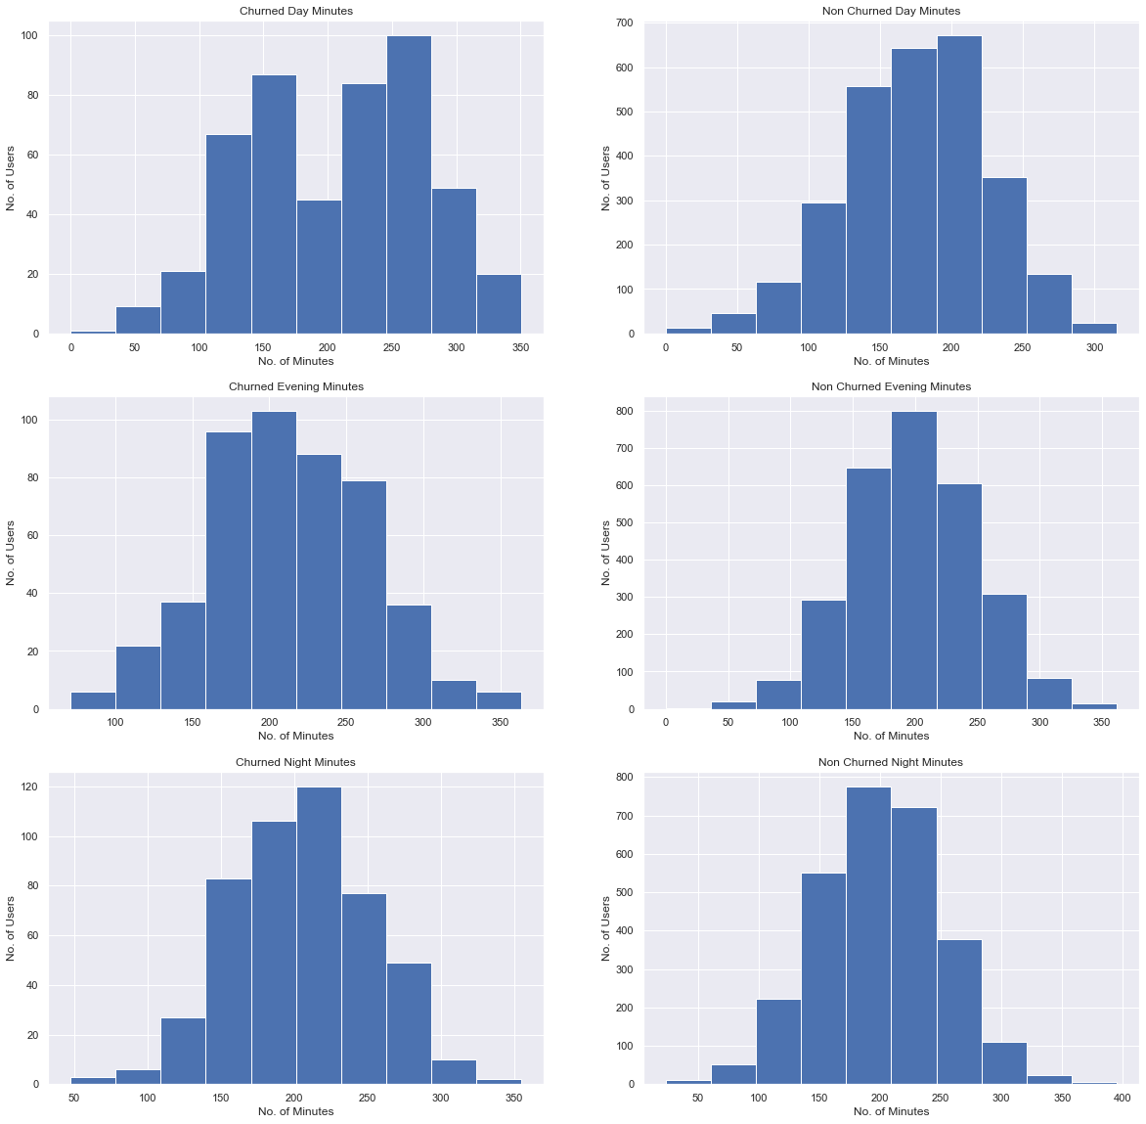
Frequency Distribution(Histogram Plot) of Churned vs Non Churned Users based Total Minutes users used during day, evening and night

Slide 7
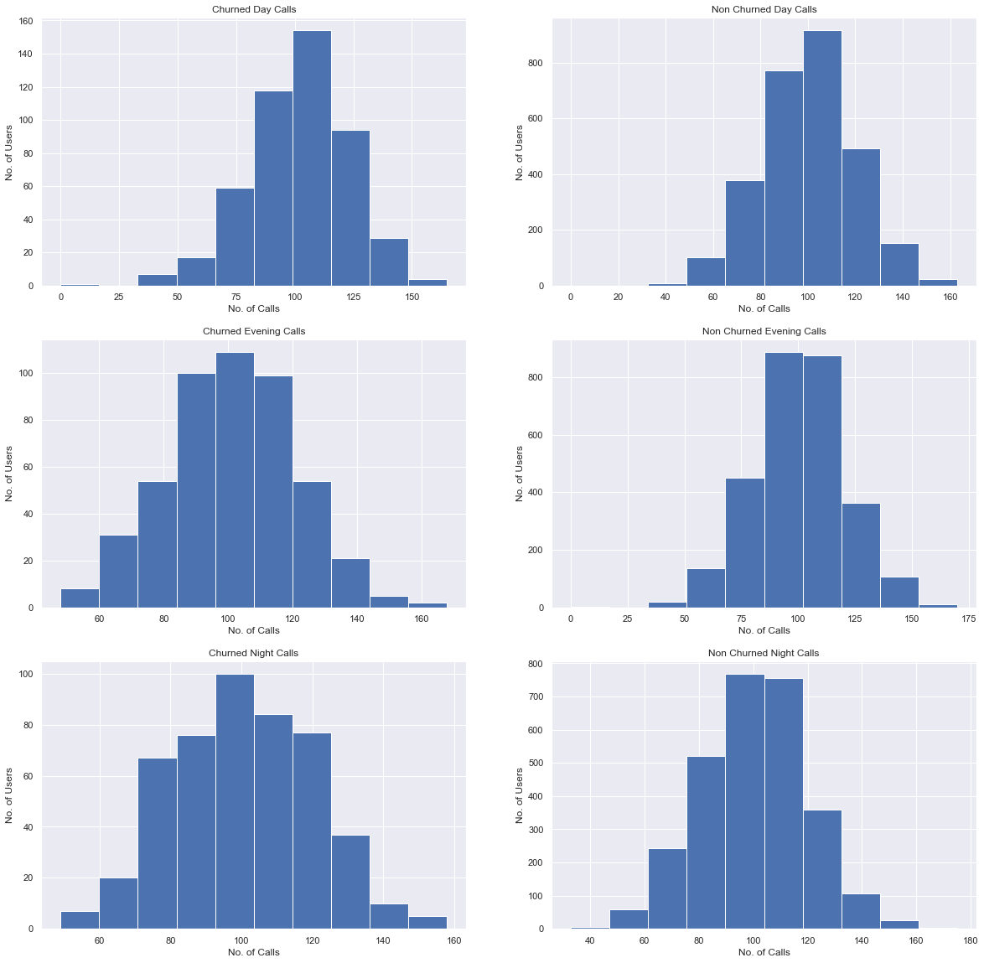
Frequency Distribution(Histogram Plot) of Churned vs Non Churned Users based Total calls users made used during day, evening and night

Slide 8

Frequency Distribution(Histogram Plot) of Churned vs Non Churned Users based Total price users were charged used during day, evening and night

Slide 9
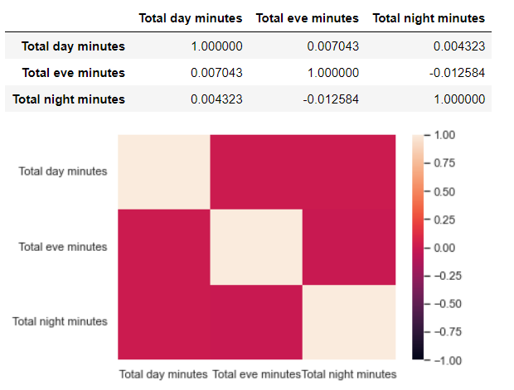
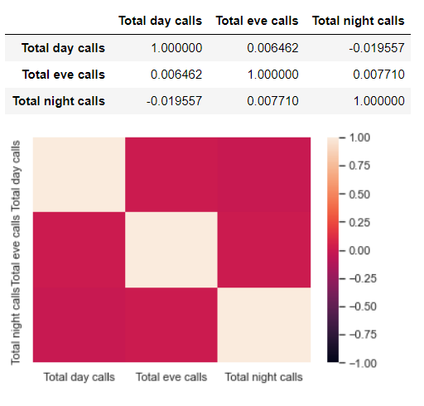
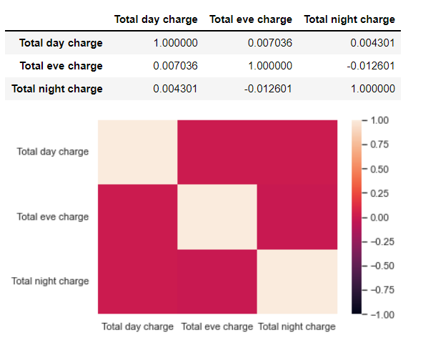
Correlation among Day, Evening and Night Times for Minutes, Calls and Charges

Slide 10
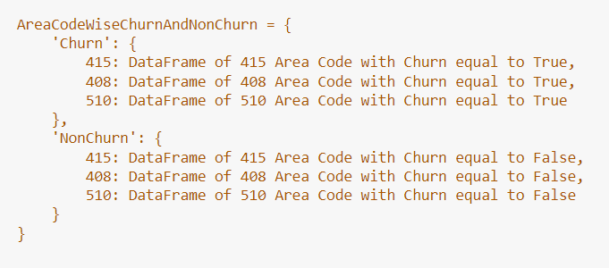
Area Code Based Analysis
We figured out from Data that there are total 3 Area Codes(415,408,510) to which users belongs to. To make analysis easier we created a nested python dictionary of the following type:

Slide 11
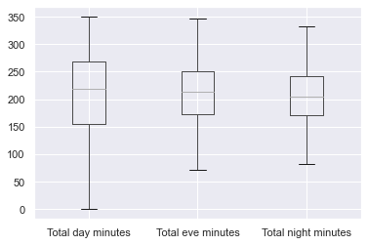
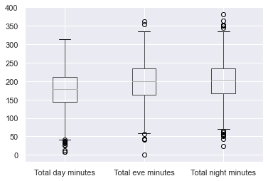
Area Code - 415
Churned Users
Non Churned Users

Slide 12
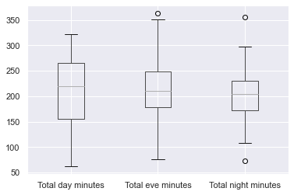
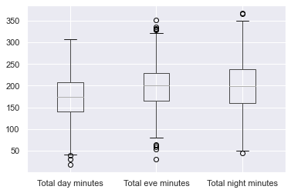
Area Code - 408
Churned Users
Non Churned Users

Slide 13
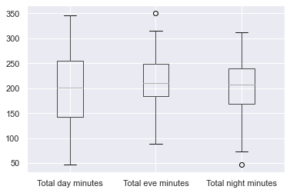
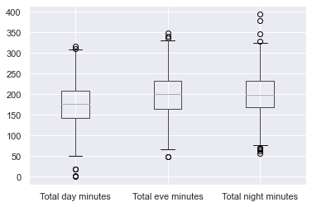
Area Code - 510
Churned Users
Non Churned Users

Slide 14
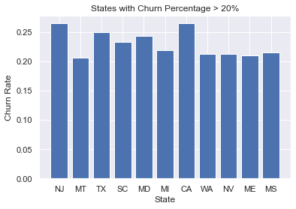
State Based Analysis
There are 51 states in total in the data set. Out of which 11 states have more than 20% Churned Rate.
Out of these 11 states, NJ and CA have highest churn rate of around 26.47%

Slide 15
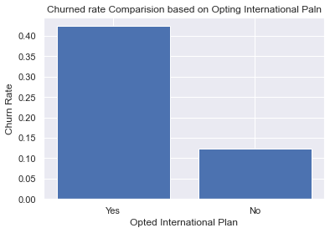
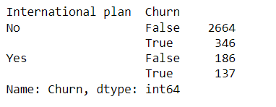
International Plan Based Analysis

Slide 16
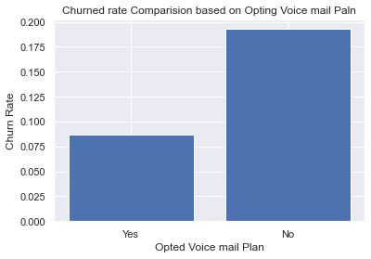
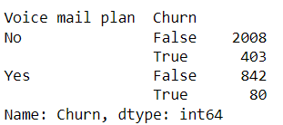
Voice mail Plan Based Analysis

Slide 17
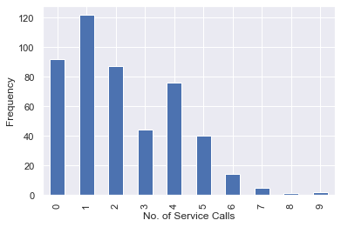
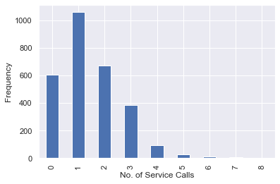
Analysis Based on Number of Customer Service Calls
Churned Users
Non Churned Users

Slide 18
Observations
Users with International Plan tend to Churn more frequently.
11 States out of 51 States have more than 20% Churn rate indicating the Telecom service is not up to expectations in those states.
Uses with Voice mail plan have very low Churn rate than others which implies that Voice mail plan of Telecom service is good.
There’s almost no(near to zero) correlation among day, evening and night time.
Users with 4 or more customer service calls Churned more than 4 times as often as other users

Slide 19
References
Numpy, Pandas, Matplotlib and Seaborn documentation.
Alma Better Recorded Classes.
Articles on Towards Data Science

Slide 20
THANK YOU

